Slide 1

Meli technical test solution
William uyasan

Slide 2
Resolution details…
This presentation is just driven to solve the concrete questions posted on the test instructions:
Opportunities@MeLi - CodeExercise DS_ML.docx
Details about data treatment, decisions, transformation and posterior modelling are better documented on the jupyter notebook:
meli_test_solution.ipynb
To replicate this exercise, please go to the following github link;
https://github.com/willyuyasan/meli_dstest
Clone the repository and go to:
meli_dstest -> brain -> meli_test_solution.ipynb
The notebook already has the printed results of all the exhaustive process

Slide 3
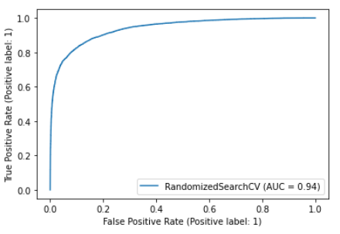
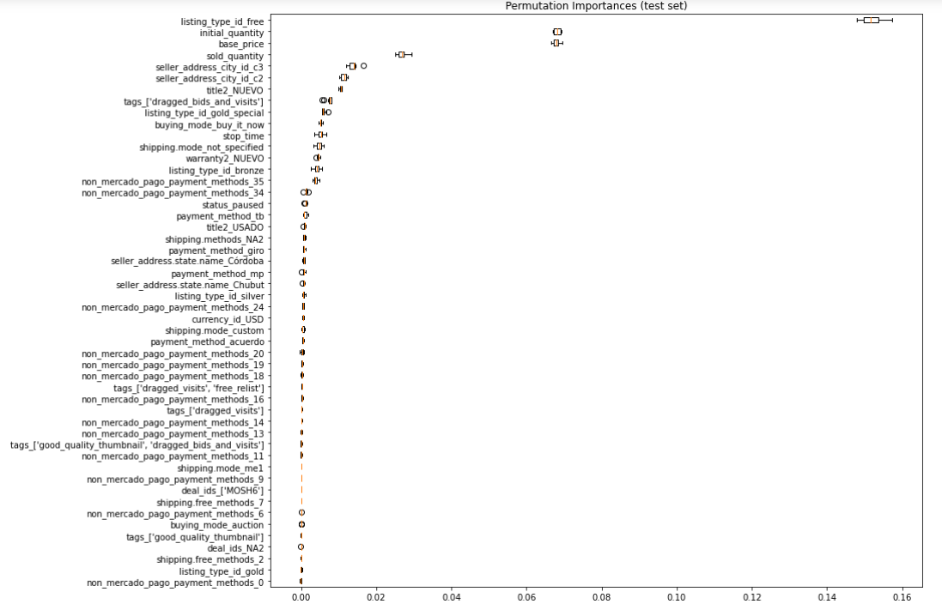
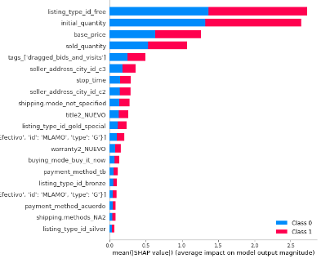
In few words:
In this exercise we obtain estimation for the “condition” target variable, which indicates if a specific object is “new” or “used” with the following performance metrics:
0.86
Accuracy
0.93
roc
For the 10,000 given observations to validate, the result can be found in: Usados -> results -> usados_estimation.xlsx

Slide 4
In few words:
It was chosen 50 variables after data preparation to participate into the model selection and calibration.
From this:
The chosen algorithm is LGBM Classifier after comparison with a base model and 2 more algorithm alternatives
For all the comparison purposes, it was performs grid search and cross validation methodology
the following variables were observed as the most important, and bring interpretability to the final model
Listing_type_id_free (onehot)
initial_quiantity (Numerical)
base_price (Numerical)
sold_quantity (Numerical)
seller_address_city_id_c3 (PCA)
seller_address_city_id_c2 (PCA)
title2_NUEVO (text analysis build)
tags_['dragged_bids_and_visits’] (onehot)
Listing_type_id (categorical) (“gold_special”)
Listing_type_id (categorical) (“free”)
buying_mode_buy_it_now (onehot)
stop_time (Numerical)
shipping_mode_not_specified (onehot)
warranty2_NUEVO (text analysis build)
Interpretability: The listing type, the available quantity, and price trends to be different between new or used products, also as the way as products are described in (title) or how the warranty is given. An odd observation is that in some cities the tendency to sell used products are above from average, See also that sold quantities can be highly different for new products

Slide 5
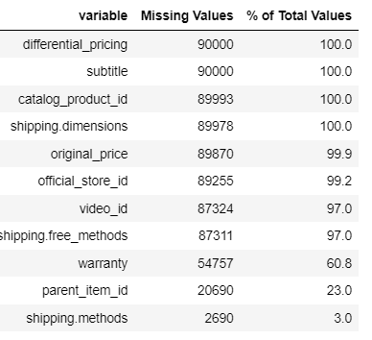
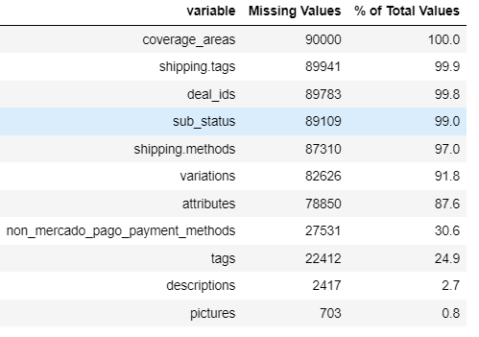
Data analysis details:
56 total variable
41 categorical
14 numerical
Sampling strategy
train
67.5K
Model fitting
train
90K
test
Total sample
22.5K
Model testing
100K
validation
Delivered in the “results” folder with estimation and probability for each class
10K
* Additional data description can be observed in the notebook

Slide 6
Data analysis details:
The given data was delivered in json array, and with the python file (new_or_used.py) this data are read. However, some data pre-processing and transformation should be performed to prepare the data for ML process and data understanding:
Data reading
Missing values treatment
Variable understanding
Adjusting variables
Data types understanding
Outliers values treatment
Target bi variate analysis
New variables computation
Data Pipeline
Model building
Correlation Analysis
Sample splitting
Target encoder
Base model
Onehot encoder
Variable selection
Cross validation definition
Algorithsm fitting
PCA transformation
Models comparison

Slide 7
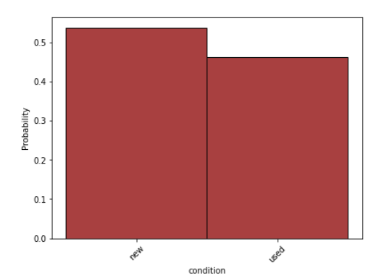


Data analysis details:
Target variable: “condition” which describes if an article is “new” or “used”
Nature problem: Binary classification
This description gives insight that the initial sample is nearly balanced between target classes. In short, for resolving this test, the sample will not be treated as a unbalanced problem and not be discussed balancing sampling methods
For make easier the computations it is declared a “target” variables where 1=“new”

Slide 8
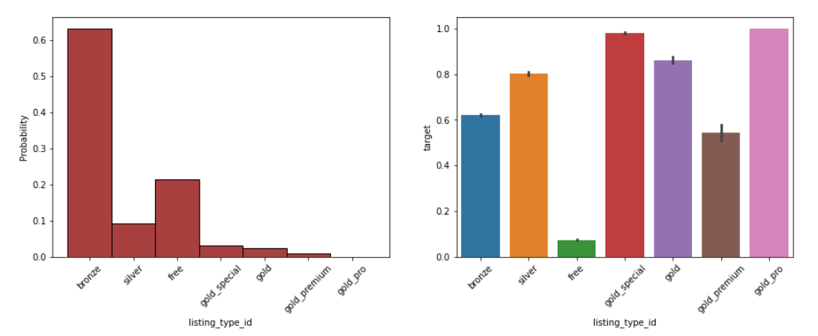
Data analysis details:
Listing_type_id
Onehot
Relevant categories
Free
Gold-special
Categories with high sample proportion and significant distinct target distribution are good insights for important model variables

Slide 9
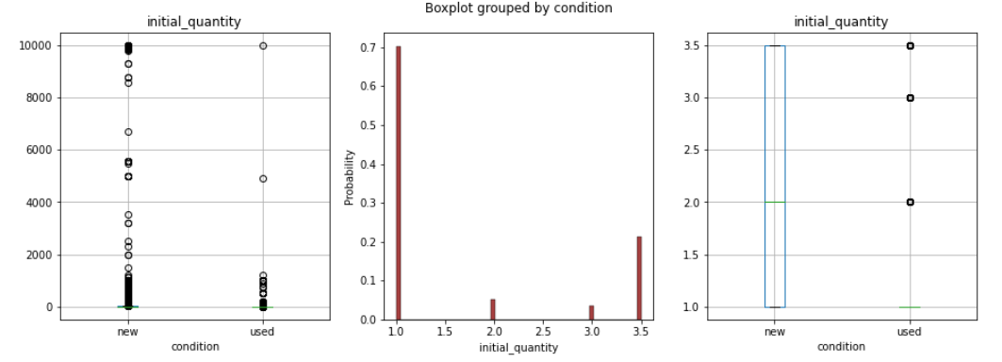
Data analysis details:
Initial quantity:
Numerical
Relevant categories
No missing values
Outliers adjustment
original
transformed
It shows different distribution between target classes
It is clear que transform the variable makes clearer the differences between classes

Slide 10
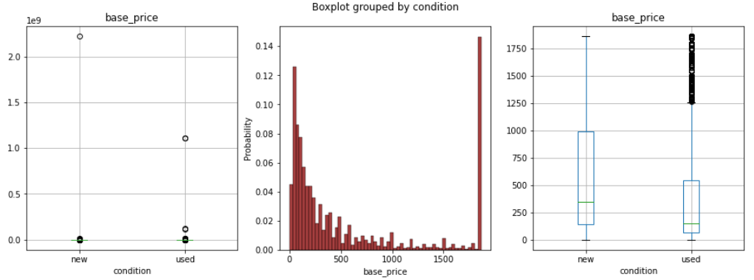
Data analysis details:
Base_price:
Numerical
Relevant categories
No missing values
Outliers adjustment
original
transformed
It shows different distribution between target classes
It is clear que transform the variable makes clearer the differences between classes

Slide 11
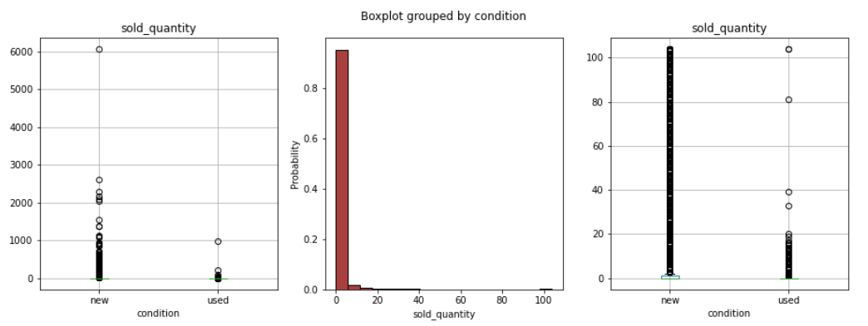
Data analysis details:
Sold quantity:
Numerical
Relevant categories
No missing values
Outliers adjustment
original
transformed
It shows different distribution between target classes
It is clear que transform the variable makes clearer the differences between classes

Slide 12
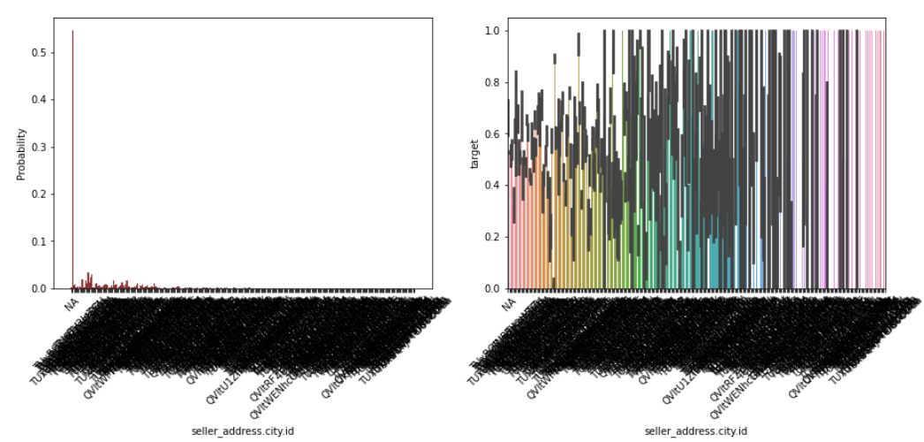
Data analysis details:
Seller address city
Onehot
PCA
Decomposition in 3 components
This variable have 285 categories including a ‘NA’ category. In this case missing values are indicated with a new NA category

Slide 13
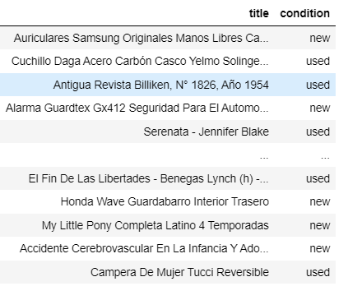
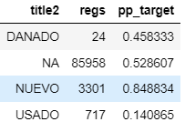
Data analysis details:
tittle
Onehot
Text analysis
Relevant categories
NUEVO
This variable have 89002 categories including a ‘NA’ category. In this case missing values are indicated with a new NA category

Slide 14
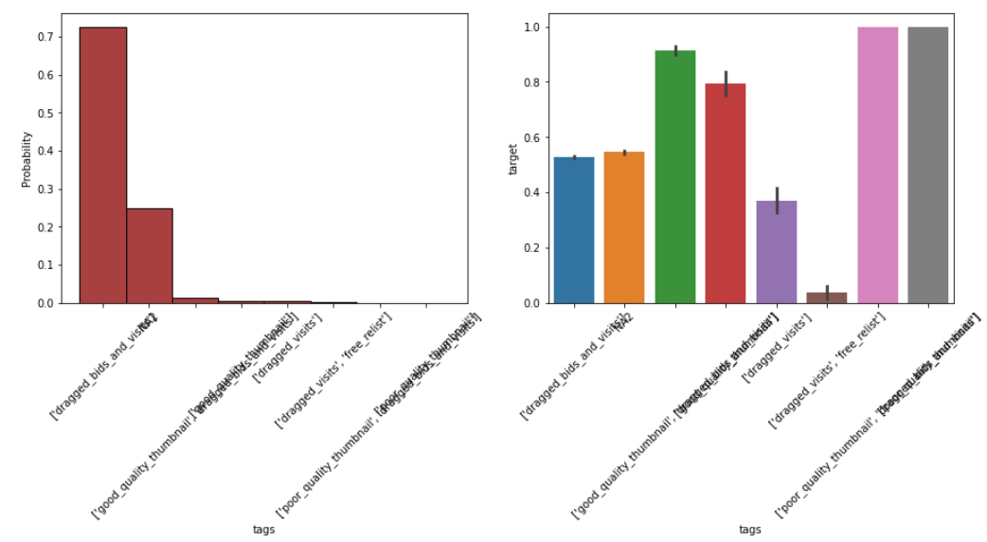
Data analysis details:
Tags
Onehot
dragged_bids_and_visits
Categories with high sample proportion and significant distinct target distribution are good insights for important model variables

Slide 15


Models comparisons:
After data preparation and variable transformation, the following methods were tested:
Base Model: Logistic regression
Model1: Logistic regression with RFE optimization
Model2: LGBM classifier with grid search
Model3: Random forest classifier with grid search
Accuracy
As the main issue is to predict correctly “new” and “used” then a performance metric that evaluates with equal importance the correct classification no matter the class is adequate. Then roc was chosen as a secondary performance metric
Roc auc
After comparison, was selected the LGBM classifier

